Slide 1
RC-LINUX Study – Team 3
Nandagopalan Venugopalan, Srikanth Kotakonda

Slide 2
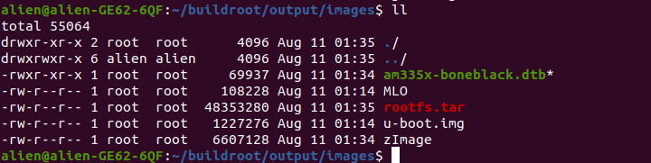
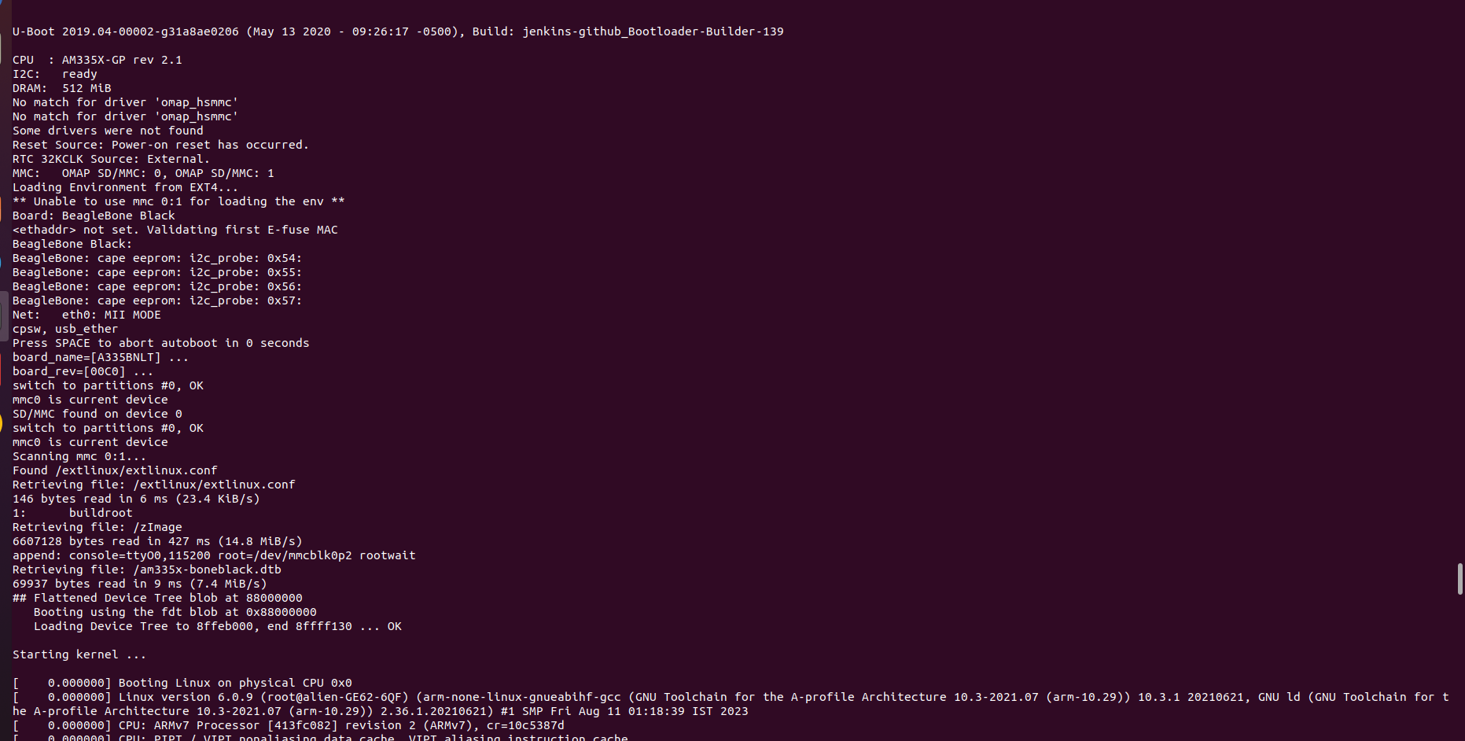
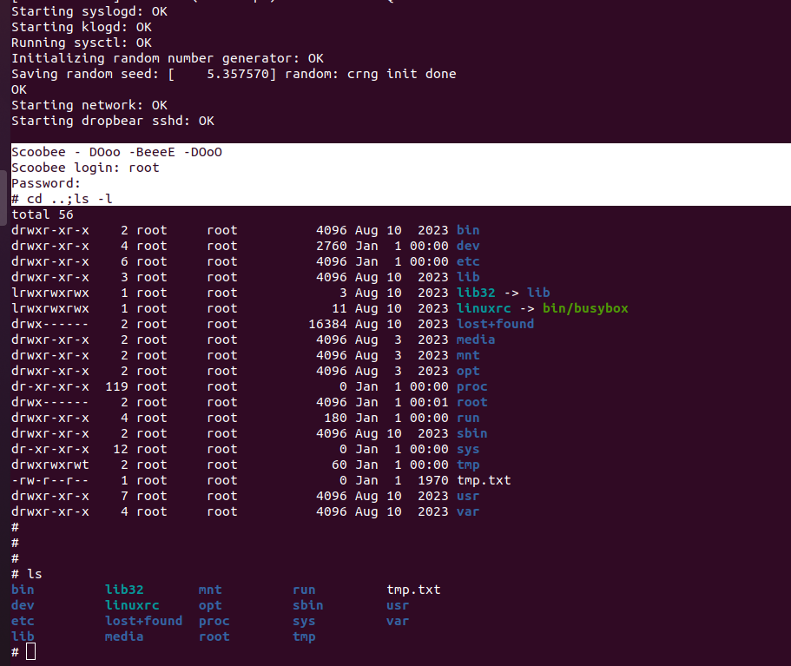
Build Root Exploration
Successfully built the image for beagle-bone black and booted the same on the embedded board.
Explored various ways of creating .config file (menu-config, *, *)
Exploring the various Kernel configuration parameters.
Trying to explore Networking aspects of U-boot (network boot using tftp).
Feasibility studies to port UEFI onto the U-boot.

Slide 3
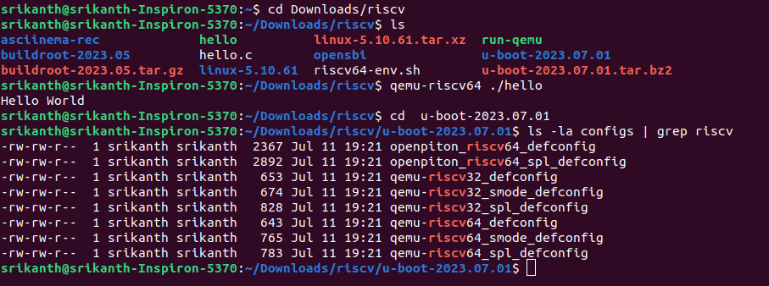
RISC-V: Summary
Building a Cross Compiling Tool Chain: buildroot-2023.05
Firmware/first stage bootloader: OPENSBI (Open Supervisor Binary Interface)
Boot Loader: u-boot-2023.07.01
Kernel: linux-5.10.61
Root File System and Application: BusyBox 1.32.1
Built Kernel Images for x86 and RISC-V
Adding Support for Networking
Resource: https://www.youtube.com/watch?v=cIkTh3Xp3dA
Implementation Logs: srikanth

Slide 4
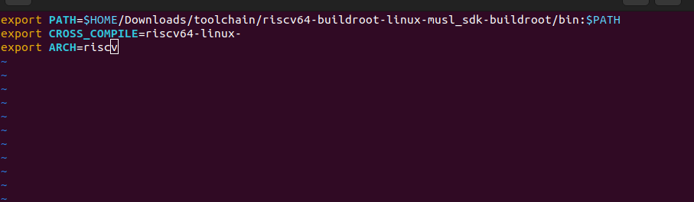
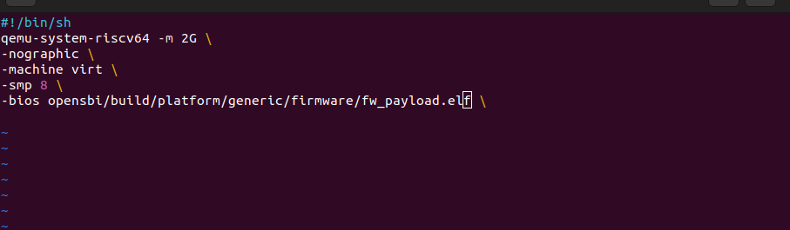
ADDING ENV Variables & EXECUTABLE

Slide 5
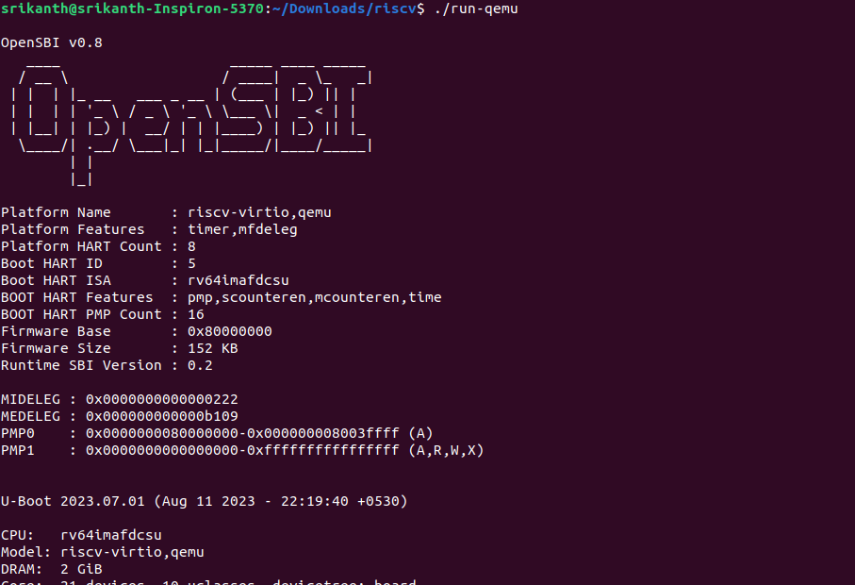
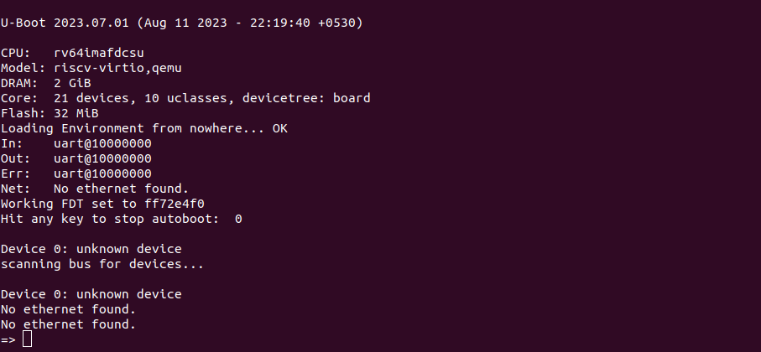
FIRMWARE/FIRST STAGE BOOT LOADER
OpenSBI (Open Supervisor Binary Interface)
It is the firmware used to start u-boot

Slide 6
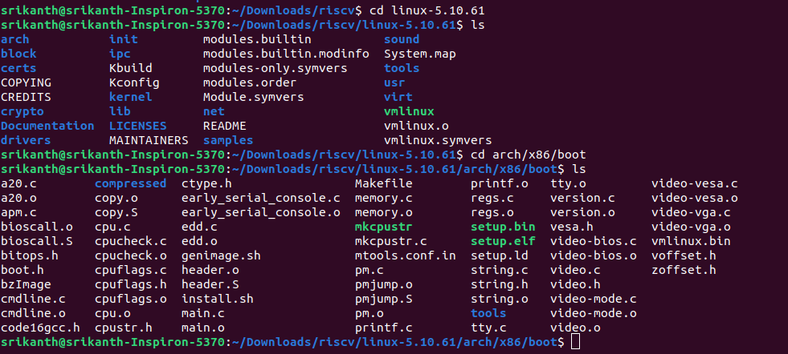
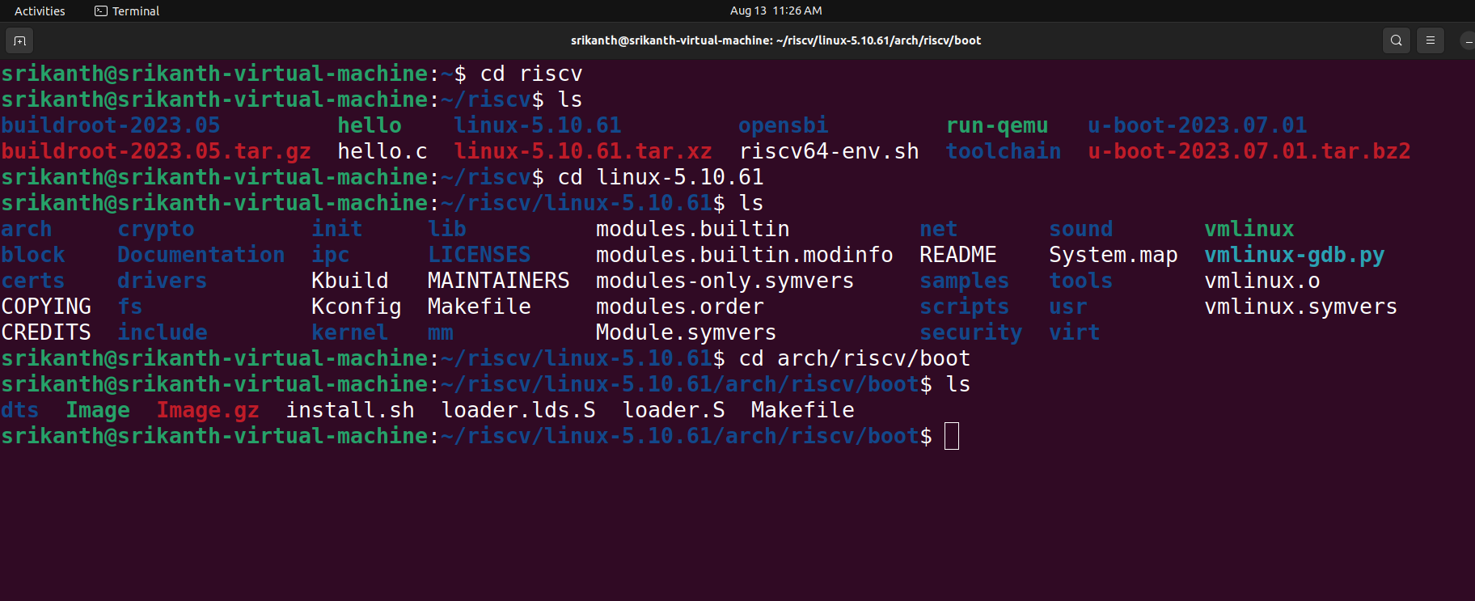
Building LINUX-KERNEL
Firstly, tried to build Linux-Kernel images for x86 and riscv

Slide 7
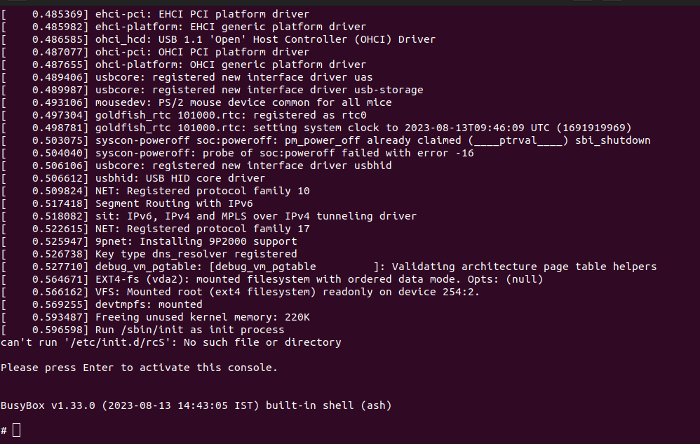
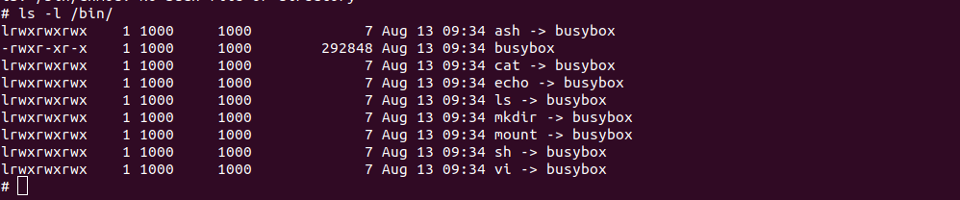
BOOTING BUSY-BOX

Slide 8
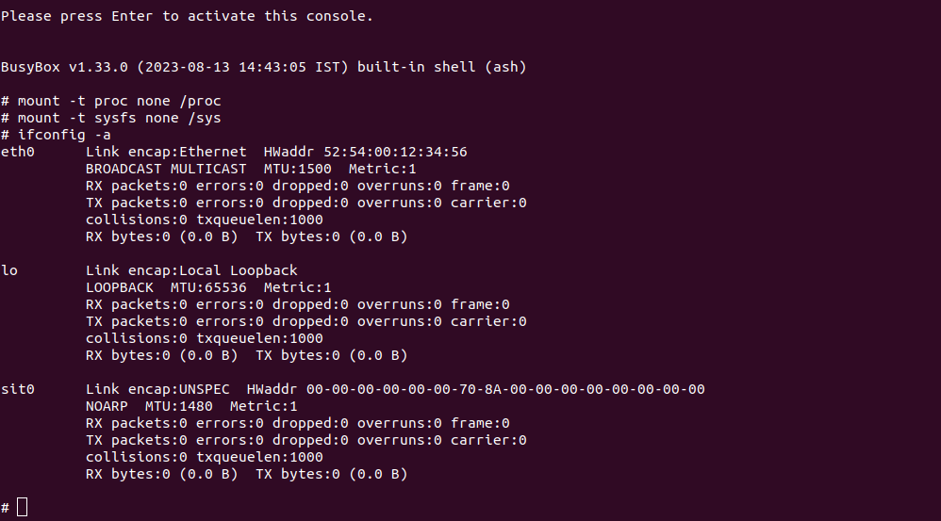
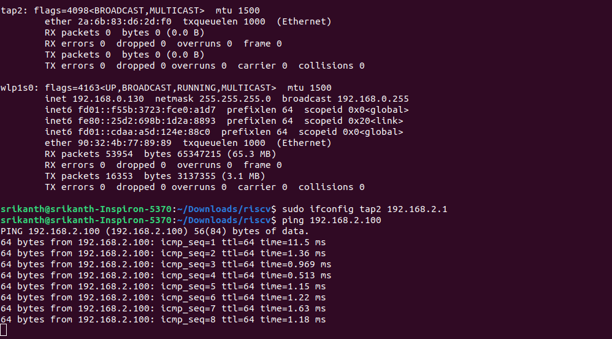
Adding N/W INTERFACE

Slide 9
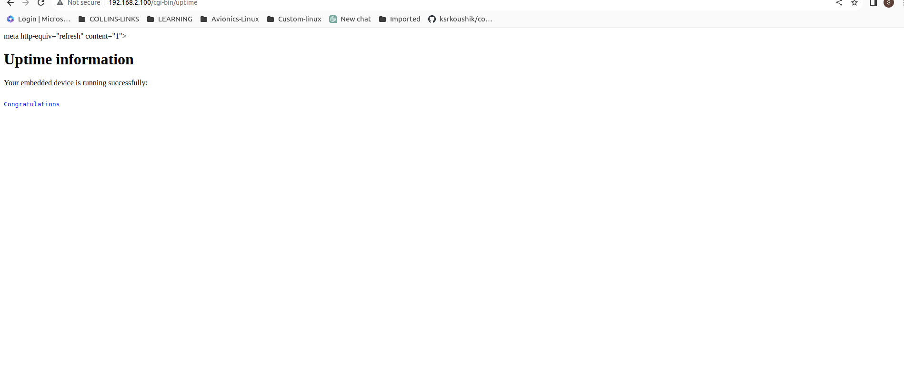
HTTP Server

Slide 10
BASICS
What is a Makefile? It is a special text file that contains instructions and rules for building the kernel's source code.
What is a .sh file and what is its purpose? It is a script file written in bash and is useful in automating tasks and executing a series of commands, for ex: Environment manipulation.
What does "make sdk" do? It creates the SDK(software development kit) based on the configuration and settings specified in the buildroot build process.
What is "menuconfig"? Generates a .config file that records our choices.
What is "defconfig"? It is a predefined configuration file that specifies default configuration settings for a particular architecture or platform.

Slide 11
Reference
Documentation : RC-Linux_Team3_Study_Documentation

Slide 12
THANK YOU

